Slide 1
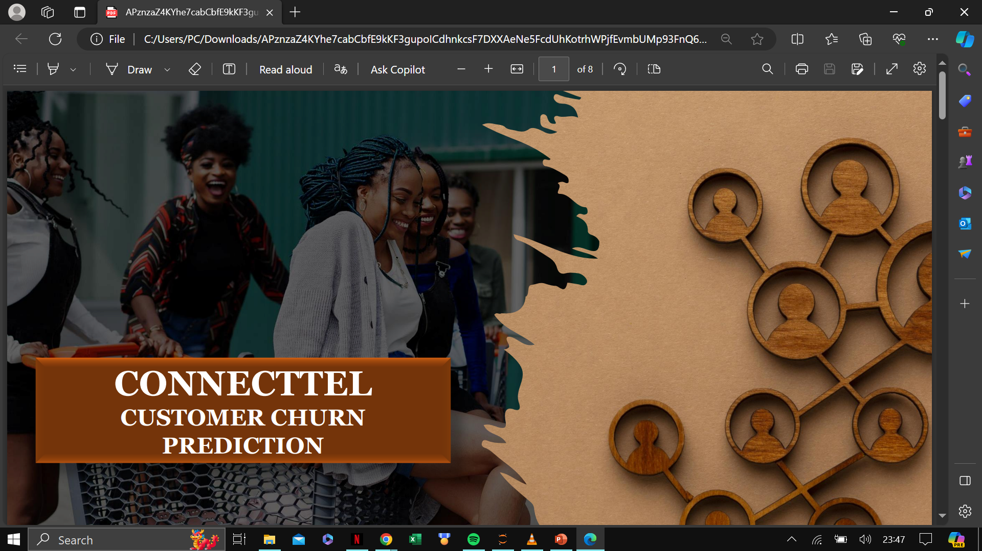

Slide 2

Introduction
Good Day, everyone. Today, I'm excited to share the results of my machine learning classifier's performance on the CONNECT_TEL telecom customer dataset. Before i dive into the results, let me begin with an overview of the dataset and the Exploratory Data Analysis (EDA) conducted.

Slide 3

Dataset Overview
Connect_tel telecom customer dataset consists of several key columns that provide valuable insights into customer behavior and churn patterns. These include:
CustomerID: A unique identifier assigned to each telecom customer, enabling tracking and identification of individual customers.
Gender: The gender of the customer, which helps analyze gender-based trends in customer churn.
SeniorCitizen: A binary indicator that identifies whether the customer is a senior citizen, aiding in understanding specific churn patterns among senior customers.
Partner and Dependents: Indicate whether the customer has a partner or dependents, influencing churn behavior.
Tenure: The duration of the customer's subscription, representing loyalty and predicting churn.
PhoneService and MultipleLines: Indicate phone service and multiple lines, affecting churn.
InternetService and subsequent attributes: Type of internet service and related features, influencing churn behavior.
Contract, PaperlessBilling, and PaymentMethod: Contract type, billing preferences, and payment methods impacting churn.
MonthlyCharges and TotalCharges: Monthly and cumulative charges, affecting churn decisions.
Churn: The target variable indicating customer churn, the focus of our analysis.

Slide 4
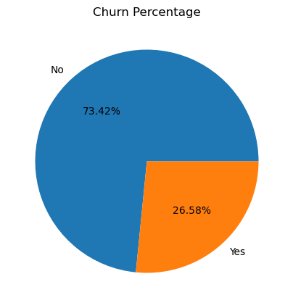
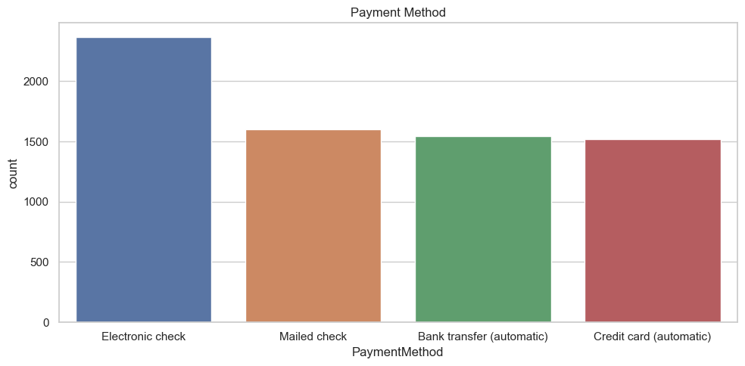
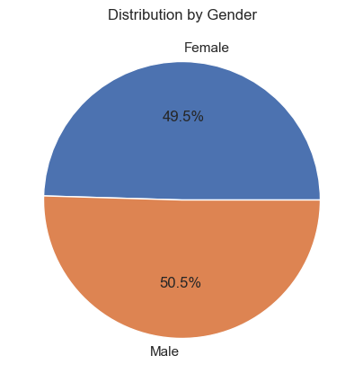
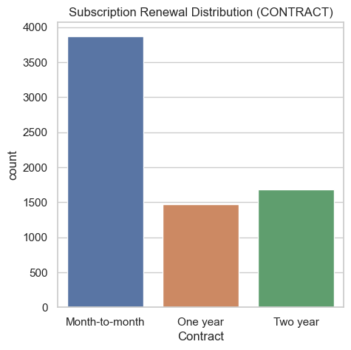
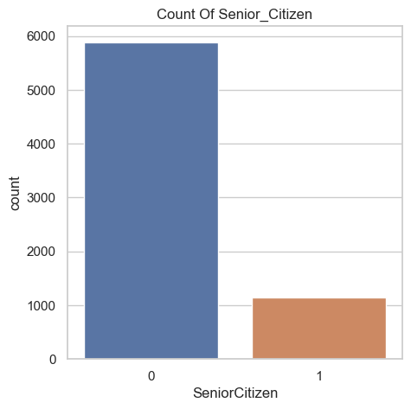
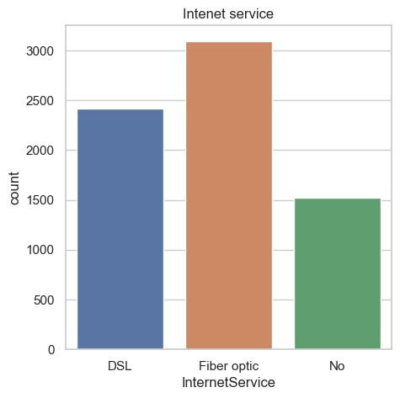
UNIVARIATE ANALYSIS

Slide 5
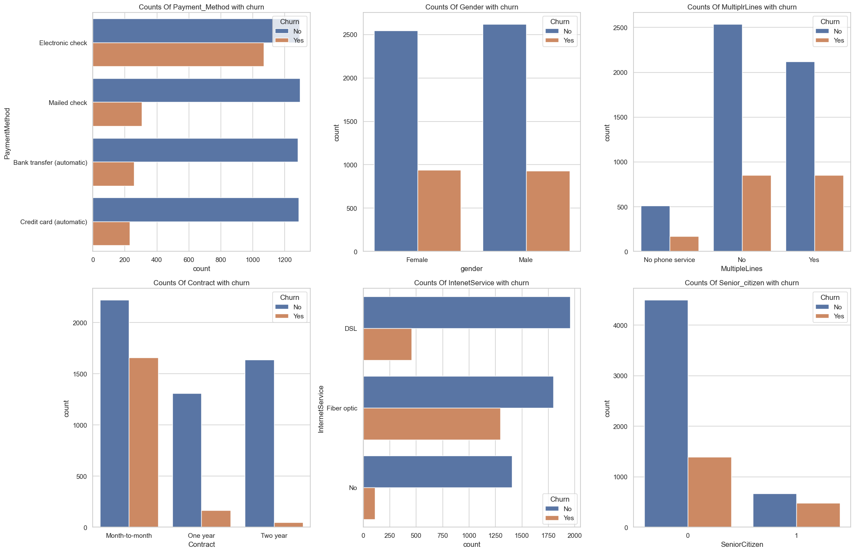
BIVARIATE ANALYSIS

Slide 6
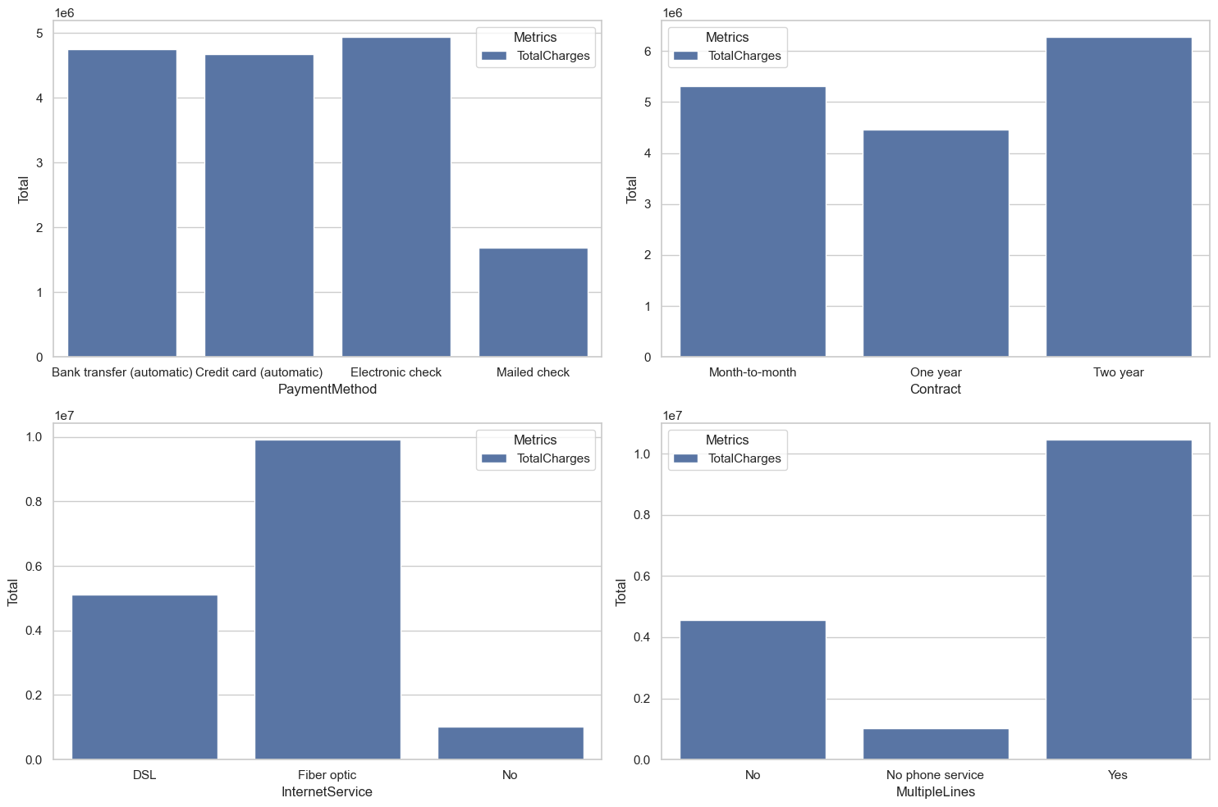
ANALYSIS ON THE AMOUNT OF REVENUE GENERATED BY :
Payment Method
Contracts
Internet Service
Multiple Lines

Slide 7

Model Selection
We experimented with several machine learning algorithms, including [Logistic Regression, Naive Bayes, XGB Classifier, Decision Trees, Random Forest, SVC, SGD Classifier.]. After rigorous evaluation and parameter tuning, By Opting out for “15” Random State, we selected the [LOGISTIC REGRESSION] as our final model due to its superior performance on our validation set.

Slide 8
MODEL PERFORMANCE
This are the Machine Learning Algorithm that was used:
 | XGB Classifier | Random Forest | SGD Classifier | SVC | Naive Bayes | Decision Tree | Logistic Regression
ACCURACY SCORE | 79.46% | 79.74% | 73.85% | 73.92% | 74.34% | 71.71% | 81.24%
PRECISION SCORE | 63.09% | 63.58% | 49.9% | 0.0% | 50.59% | 46.15% | 66.78%
ROC/AUC SCORE | 70.32% | 70.87% | 71.9% | 50.0% | 73.12% | 64.91% | 73.03%
RECALL SCORE | 51.23% | 52.32% | 67.85% | 0.0% | 70.57% | 50.68% | 55.86%

Slide 9
Conclusion
In conclusion, The machine learning algorithm has demonstrated promising results in predicting customer churn based on Connect_Tel telecom customer dataset. Moving forward, we'll continue to refine our model, explore additional features, and gather more data to further enhance its performance.

Slide 10

Questions and Discussion
I'm now open to any questions or discussions regarding our classifier's results, methodology, or any other related topics.

